Slide 1
Report Presentation of CSE350
Section : 01
Course Instructor : Maheen Islam
Dept. of Computer Science and Engineering
Presented By:
i) Sakibur Rahman - 2014-1-60-032
ii) Riajul Islam - 2014-2-60-087
iii) Akash Ahmed - 2014-3-60-

Slide 2
Satellites

Slide 3
A satellite is an object in space
that orbits or circles around a
bigger object.

Slide 4
Two kinds of satellites
Natural
Moon orbiting the Earth
There are dozens upon dozens of natural satellites in the solar system, with almost every planet having at least one moon. Saturn, for example, has at least 53 natural satellites
Artificial
International Space Station orbiting the Earth

Slide 5
Natural Satellites?

Slide 6
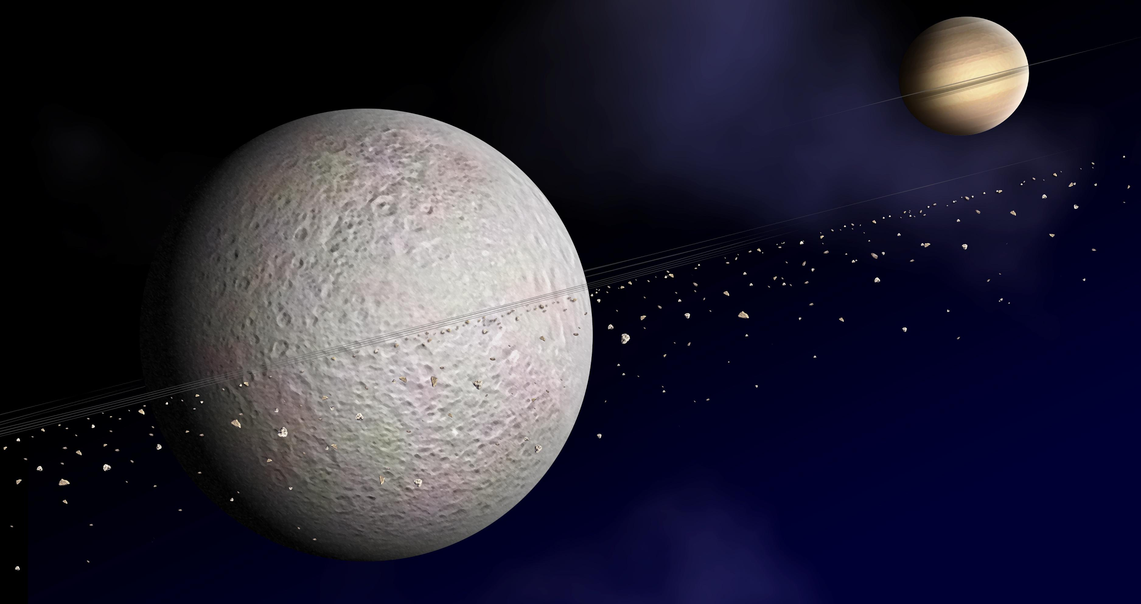

Slide 7
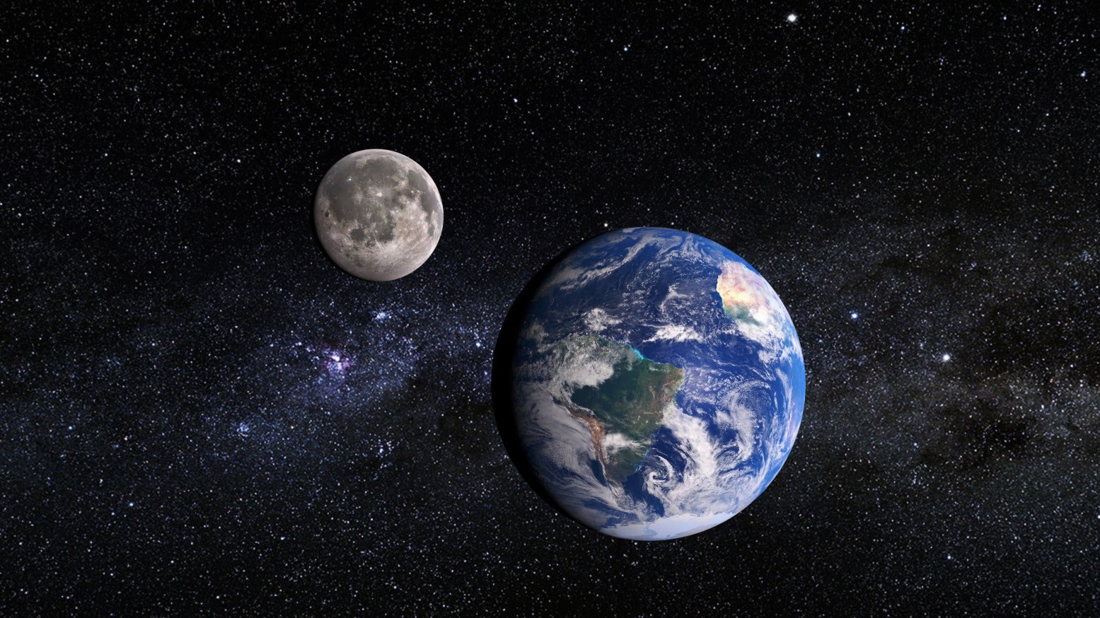

Slide 8
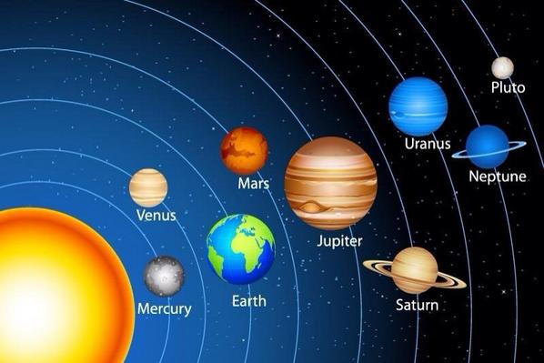

Slide 9
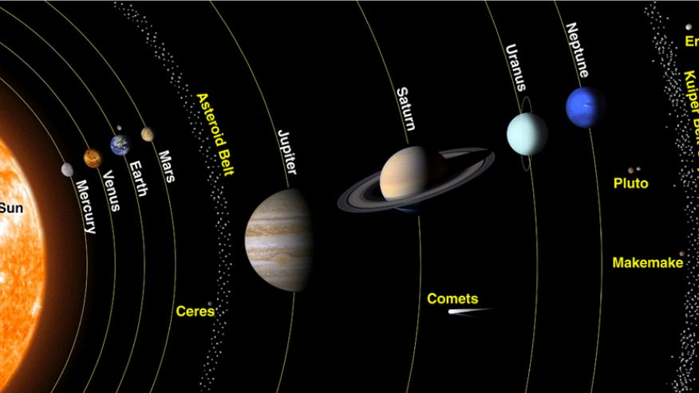

Slide 10
Artificial
Satellites?

Slide 11
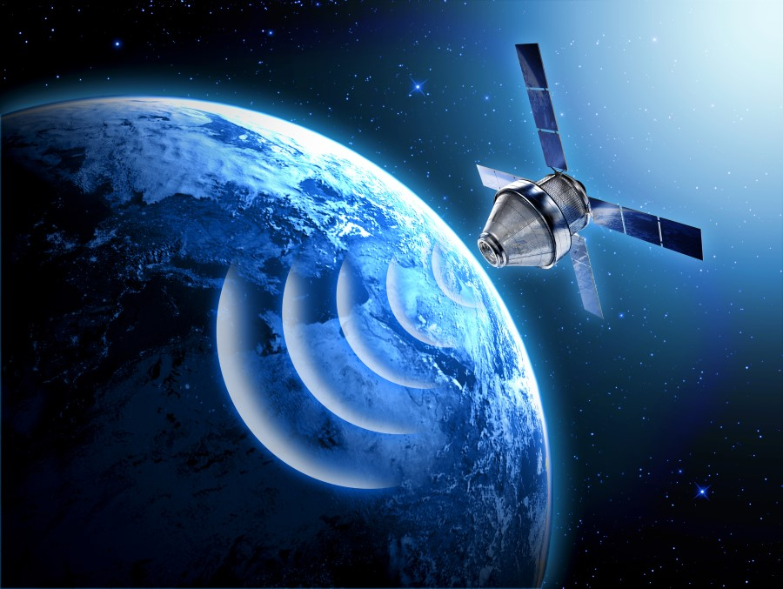
This

Slide 12
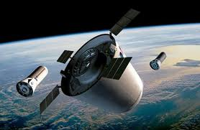

Slide 13
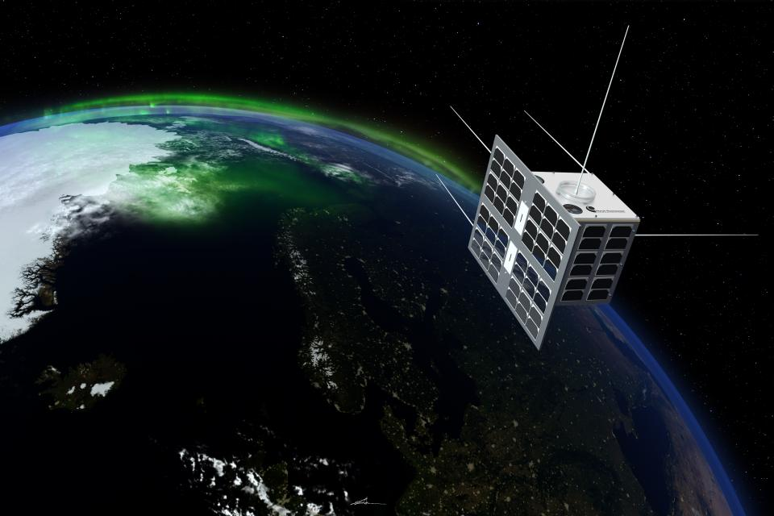

Slide 14
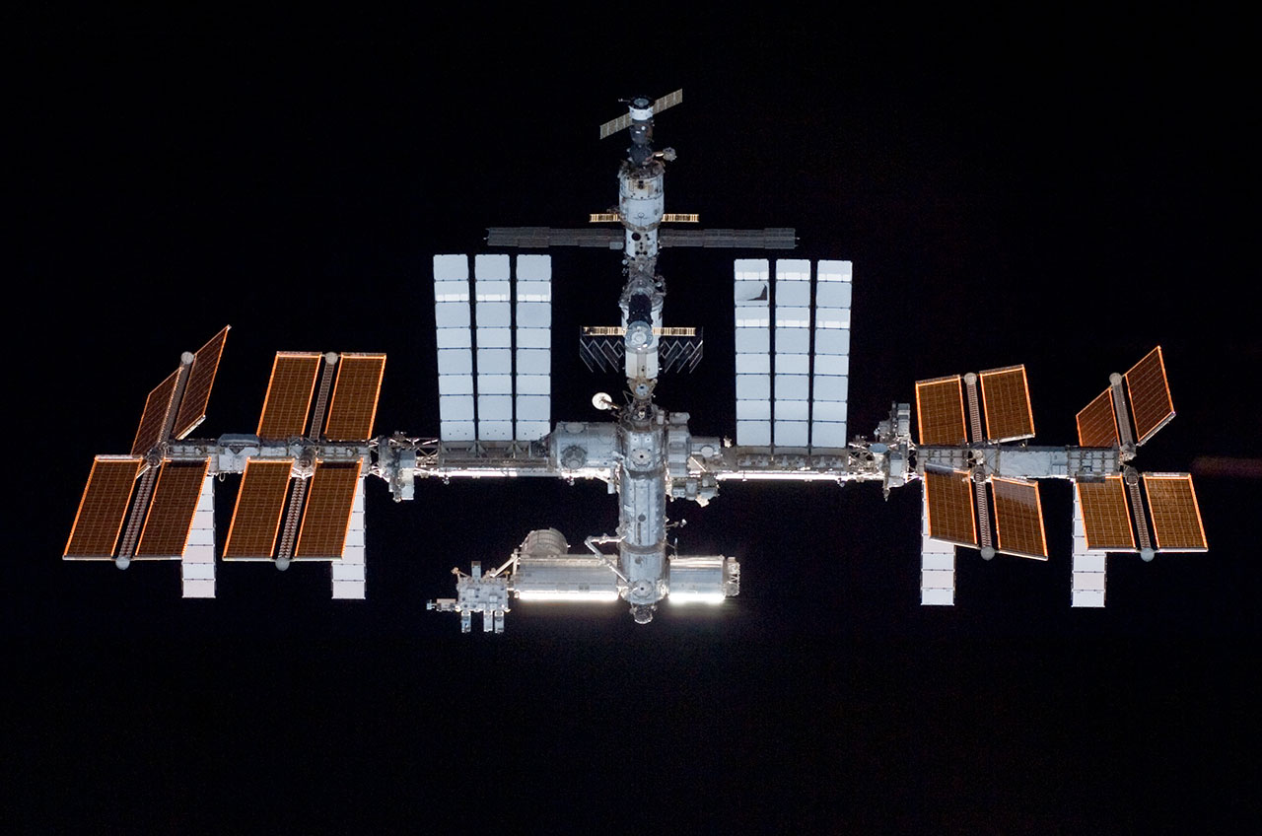
The International Space Station is the largest satellite in orbit. This file photo of the station was taken in May 2010 by NASA space shuttle astronauts. Credit: NASA

Slide 15
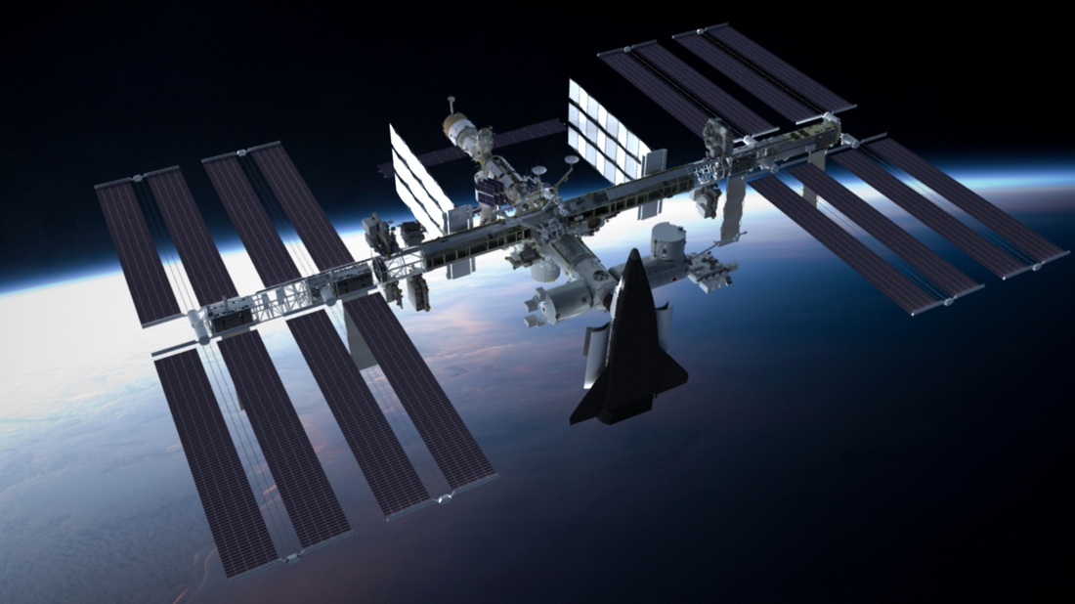

Slide 16
Artificial
Satellites
Our Goal

Slide 17
Artificial satellite
Invention
Story

Slide 18
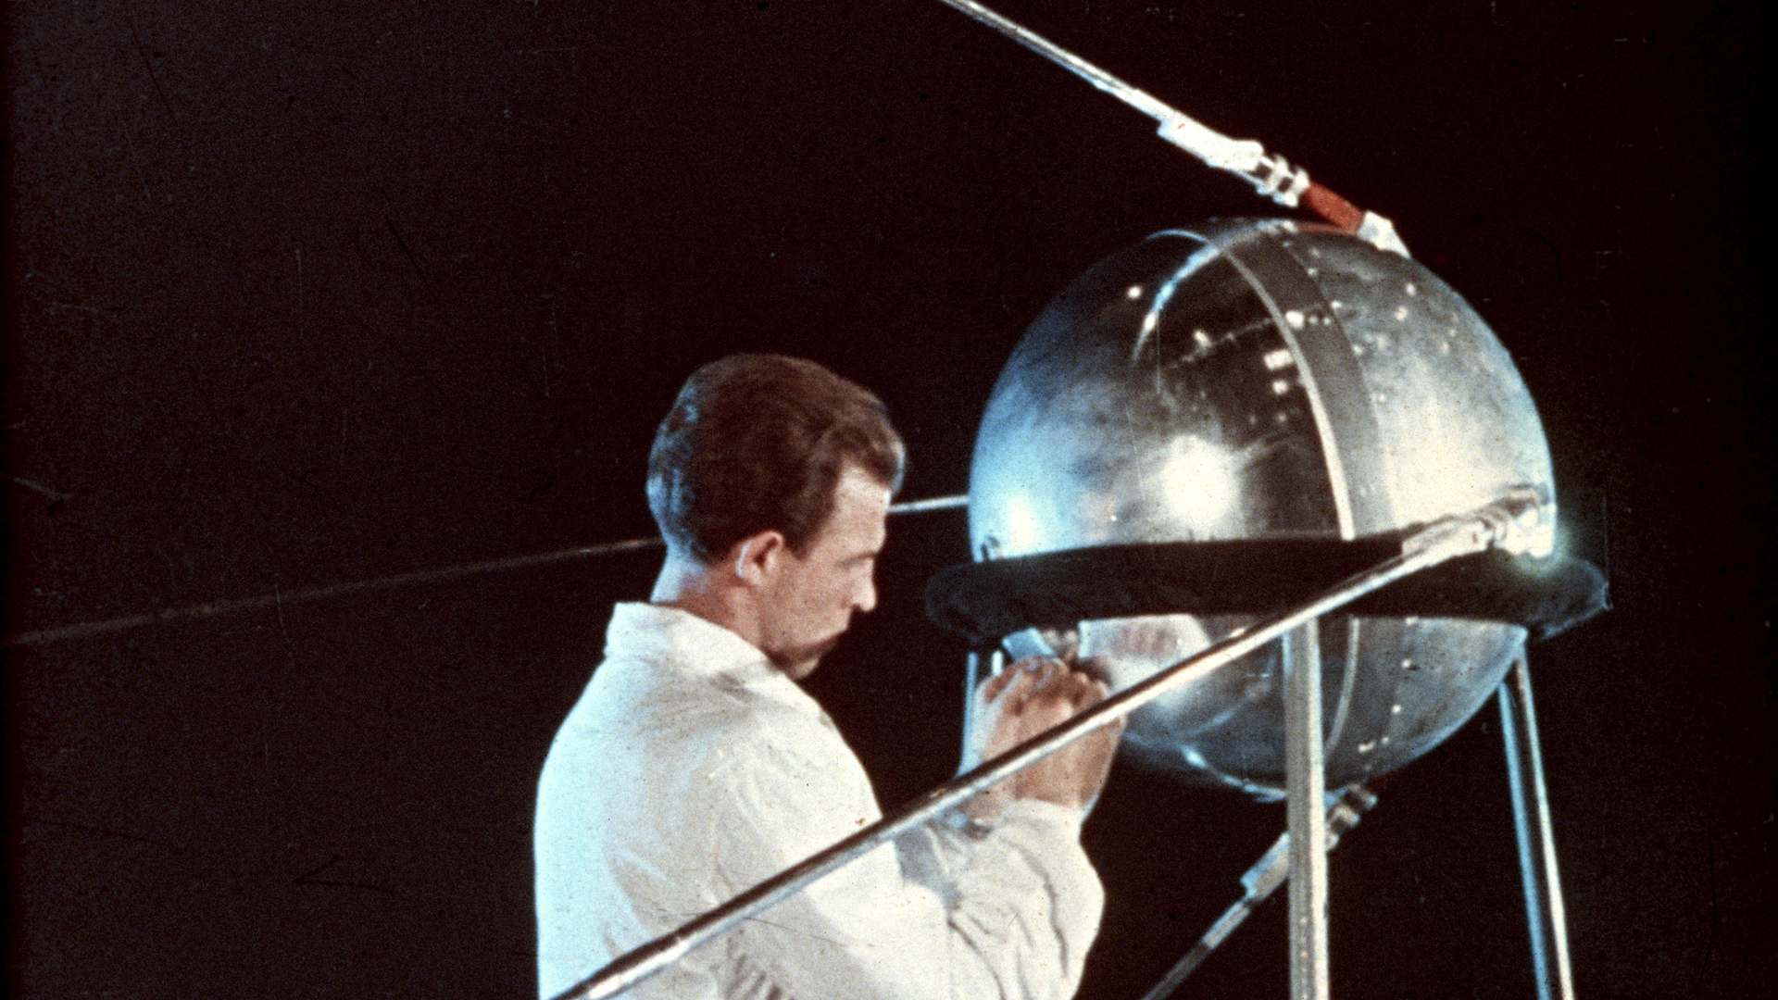
History changed on October 4, 1957, when the Soviet Union successfully launched Sputnik I. The world's first artificial satellite was about the size of a beach ball (58 cm.or 22.8 inches in diameter), weighed only 83.6 kg. or 183.9 pounds, and took about 98 minutes to orbit the Earth on its elliptical path.

Slide 19
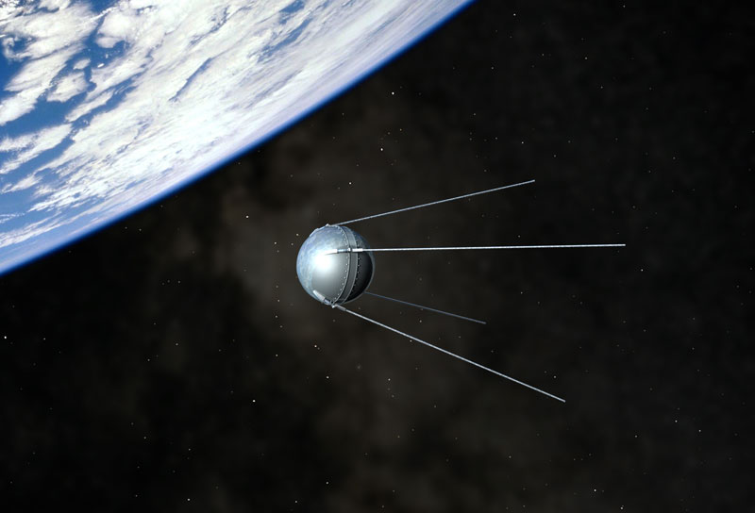

Slide 20
How satellite works...

Slide 21
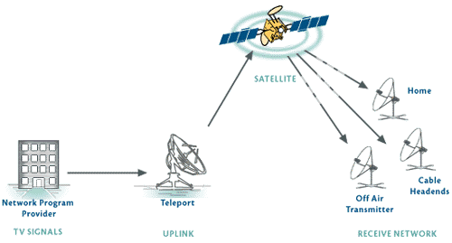

Slide 22
Types of Satellites

Slide 23
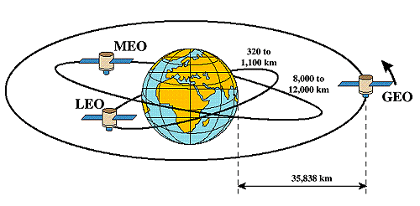

Slide 24
We have seen already...

Slide 25
Types, Installation and Operation
of Satellites

Slide 26
Is it a satellite?

Slide 27
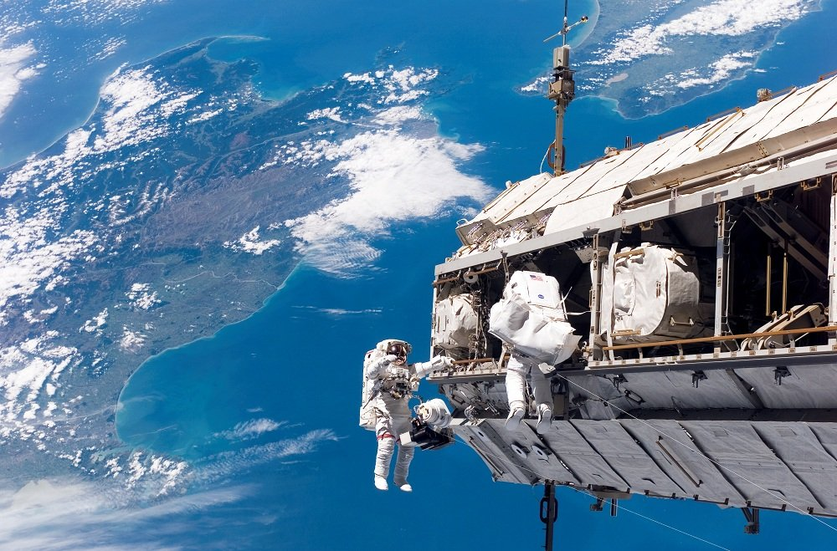

Slide 28
Yes !!!

Slide 29
No !!!

Slide 30
Very good

Slide 31
Is it a satellite?

Slide 33
Wrong Answer: No
Right answer: Yes

Slide 34
Space Station

Slide 35
How Are Satellites Repaired In Space?

Slide 36
NASA astronauts Scott Kelly and Tim Kopra will likely perform an unexpected spacewalk, to fix a rail car that stalled on the outside of the International Space Station (Dec 21, 2015)

Slide 37
Satellite
Applications

Slide 38
Long distance transmission of
Television programmes
Telephones communication
Internet

Slide 39
Used for
Research
Defense
Remote sensing: collecting information from a distance

Slide 40
GPS: Global positioning system
Weather info collection
Agriculture
Land and ocean features including movement of fish in oceans

Slide 41
Simply saying,
Where not...

Slide 42
Satellite
Business

Slide 43
In previous
We’ve seen ...

Slide 45
Now...

Slide 46
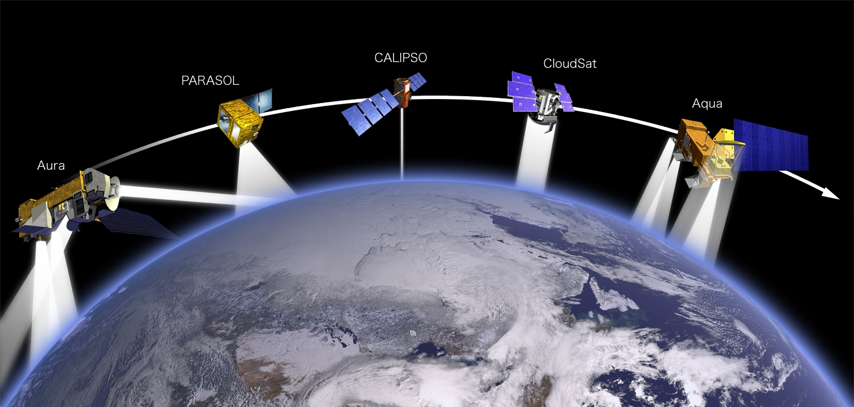

Slide 47
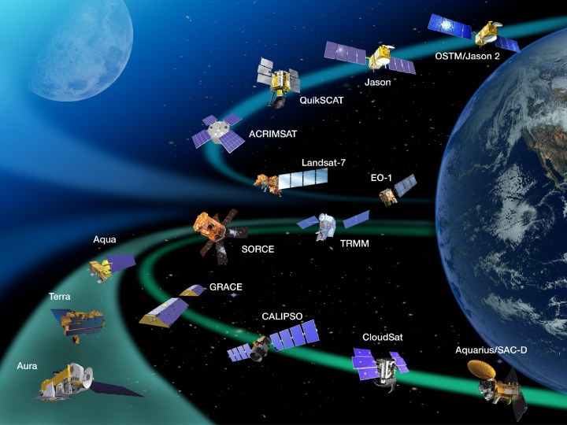

Slide 48
Too many Satellites

Slide 49
Multi billion $ business

Slide 50
Satellite being key to building
the future digital highways requires all players work together
striving for innovation
meeting market challenges
To solve problems

Slide 51
Need business model

Slide 52
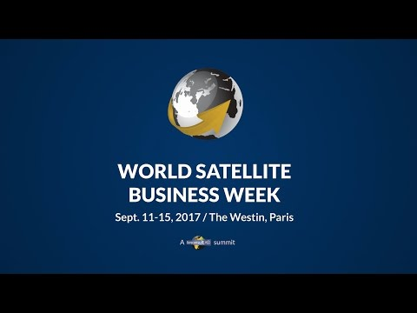


Slide 53
Any Questions?

Slide 54
Thank you

